Slide 1
Heat Transfer

Slide 2

Heat transfer is the movement of heat from one object to another object.
This heat always flows from the hotter object to the colder object.
This heat transfer is fastest when there is a large temperature difference.

Slide 3
By the end of this Smart Lesson you will be able to:
Compare heat and temperature.
Describe the different mechanisms for heat transfer.

Slide 4

You may think that heat is the same as temperature.
It turns out that these are actually two different concepts.
Heat is a type of energy. It is the sum of the kinetic energy of particles within a substance. It is measured in joules (J).
Temperature is the average kinetic energy of the particles in a substance. It is measured in degrees Celcius (∘C).

Slide 5

This video (1:29) explains the difference between heat and temperature.

Slide 6
For example, a pot of boiling water has less heat than a massive iceberg, even though it has a higher temperature.
This is because the iceberg has more particles in it than the boiling water. When you add the kinetic energy of all these particles together you get a larger number, and therefore more heat.

Slide 7
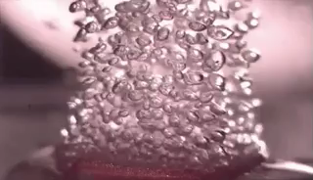
However, the average kinetic energy of the particles in the iceberg is less than the average kinetic energy of particles in the boiling water.
This means the iceberg is a lower temperature than the boiling water.

Slide 8
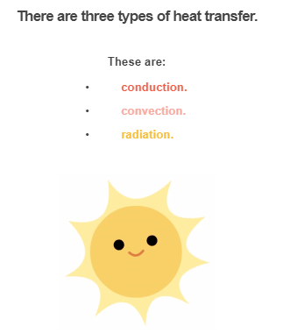

Slide 9

Conduction is the first method of heat transfer.
Conduction only occurs between two objects which are in direct contact. This means that the objects have to be touching.

Slide 10
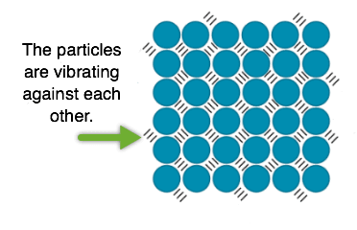
Conduction occurs because of particles vibrating within objects.
These particles are always vibrating. However, they vibrate faster in hotter objects.

Slide 11
When a hot object is in contact with a cold object, the quickly vibrating particles in the hot object will bump into the slower vibrating particles in the cold object.
This causes the particles in the cold object to vibrate faster, increasing the temperature of the object.
Voila! Heat transfer has occured.

Slide 12

The second method of heat transfer is convection.
Objects do not need to be in contact for this type of heat transfer.
Convection occurs via fluids. Fluids is a term which includes both gases and liquids.

Slide 13
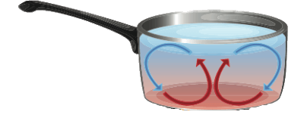
First, one part of the fluid is heated, causing the particles to move apart.
This makes this part of the fluid less dense than the surrounding fluid, causing it to rise.
Cool fluid moves into the space freed up by the less dense part of the fluid. This then gets heated and rises.

Slide 14
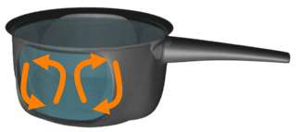
The heated fluid cools down as it moves away from the heat source.
This causes it to become more dense and sink again.
The fluid can then be heated again, continuing the cycle.
This movement of fluid is called a convection current.

Slide 15
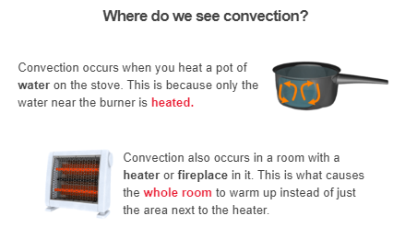

Slide 16

Radiation is the final method of heat transfer.
Every object radiates heat. This heat is transmitted as invisible waves which move at the speed of light!
Radiation transfers heat by waves, not particles like conduction or convection. This means that it can travel through the vacuum of space!
In physics terms, we say that radiation does not need to travel through a medium to transfer heat.

Slide 17
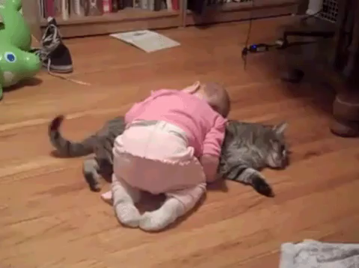
Every object radiates heat, even if we can't feel it.
You are radiating heat right now!
Hotter objects radiate more heat.
Some examples of objects which radiate heat are the Sun, a fire, your pet cat.... the list goes on and on!

Slide 18
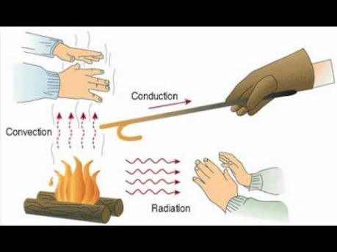
This video (0:48) gives a brief summary of convection, conduction, and radiation.

